Slide 1
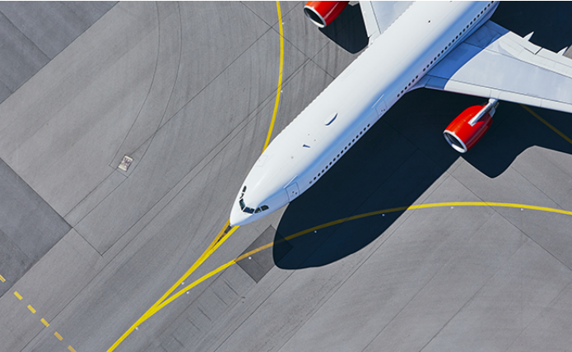
Airline Safety
Saroj Raut
DSC 640
Executive Summary

Slide 2
Airline safety study
Introduction: With recent plane crash around the world that killed hundreds of people and the missing of MH370, travelers might question whether flying has become less safe. Aviation expert sees the recent incidents are a fraction of what they were as recently as the 1990s and the other transportation mode such as vehicles. The study is to investigate the data and submit the report of the findings.
Scope:
Airline Fatalities/Incidents
Vehicle Fatalities/Crash Report
Air Travel and Safety

Slide 3
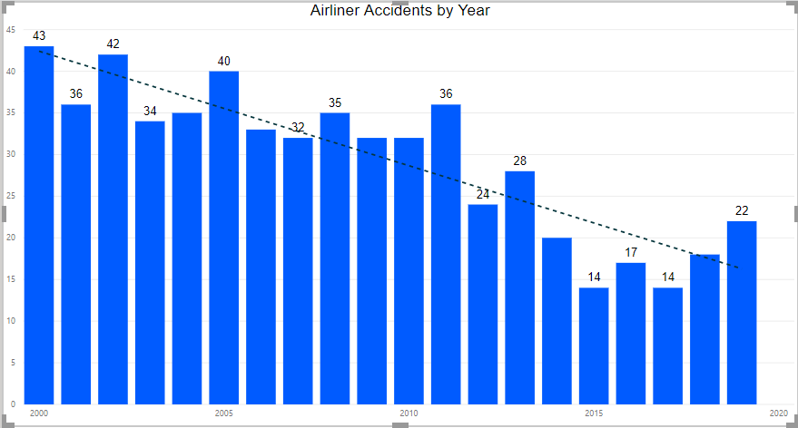
Airline Accidents by Year
Graph showing airline is becoming more and more safe for travel each year.

Slide 4
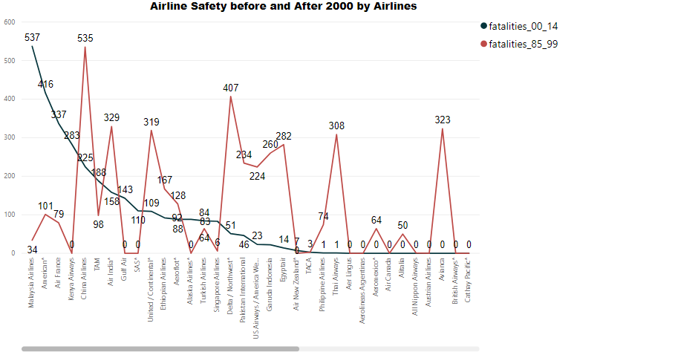
Airline fatalities stats
Graph showing significant drop in airline fatalities since 1999 compare to the year prior to that.

Slide 5
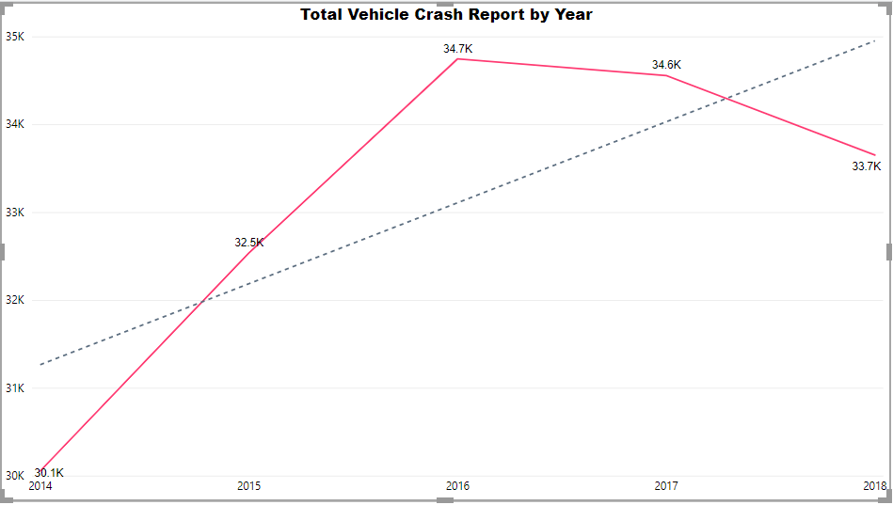
Vehicle crash report
Line graph showing vehicle crash report each year.

Slide 6
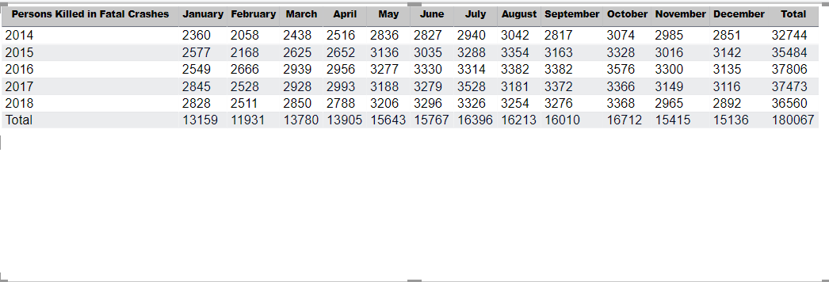
Person killed in vehicle crash
The vehicle crash report shows fatalities in thousands each month.

Slide 7
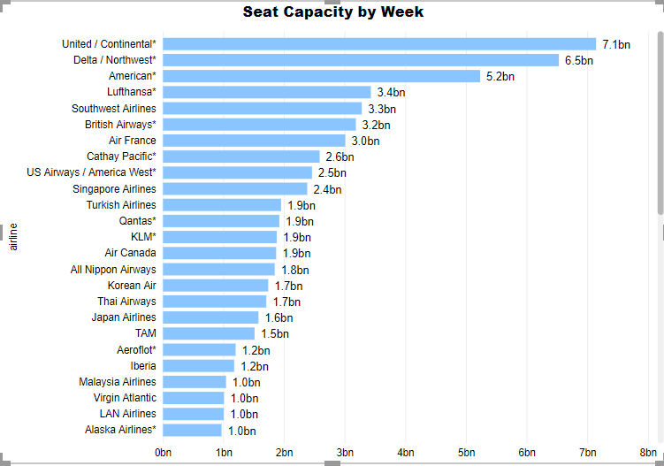
Seat Capacity airline
United has the highest seat capacity compare to the other airlines. Millions of customer travel each day.

Slide 8
findings
Study and reports confirmed there has been significant drop in airline fatalities since 1999.
Overall, flight incidents or fatalities are at a declining rate with the advancement of time and technology
Vehicle crash/fatalities are significantly higher compare to the air travel.
The line chart shows the no of airline accidents has been significantly reduced after 1999 which strongly suggest advances in aircraft and airport design, better air traffic control, and improved pilot training.
Comparison of the airline travel incident with the road fatalities/incident found airline to be extremely safe .

Slide 9
Summary
Airline Safety study present the statistics of the airline fatalities and compare that with the vehicle crash report. The report illustrate that there has been significant drop in airline fatalities after 1999. Multiple metrics is created to support the study and its finding.
First slide: It provides an overview and the purpose of the study with the scope for the study.
Second: Airline accident is decreasing each year after 1999. I have shown bar graph along with the line for patterns that shows it is decreasing year over year. It tells airline is becoming more and more safe for travel each year.

Slide 10
Summary
Third Slide: The airline fatalities has two-line graph to show the before and after 1999 stats of the airline accident. The maroon red is chosen to show the high fatalities compare to brown line for fatalities after 1999.
Fourth Slide: The line graph is drawn to show the vehicle crash fatalities in various time as a continuous data. The color -blind friendly palate is used to show the fatalities increasing each year.
Fifth Slide: The vehicle crash fatalities is included in the detail slide to show the total death each month. I have included it in detail table format to make it easy for reader to study the Metris.
Sixth Slide: The light blue color is used to show the capacity of airline each week. Description is added to provide context and more clarity to the user.
Seventh Slide: The finding of the study is included to provide summary from the study of data.

Slide 11
References
1. Airline Fatality by Type(GIT)
2. CrashReport count (GIT)
3. CrashReport Vehicles(GIT)
4. CrashReport Fatalities(GIT)
5. Airline Data Project(GIT)

